Slide 1
Task 1
Input a string with the help of dialog box from the user and find out the following things against the entered string:
  Number of digits in the string
  Number of characters in the string
  Number of blank lines in the string
  Number of special characters

Slide 2
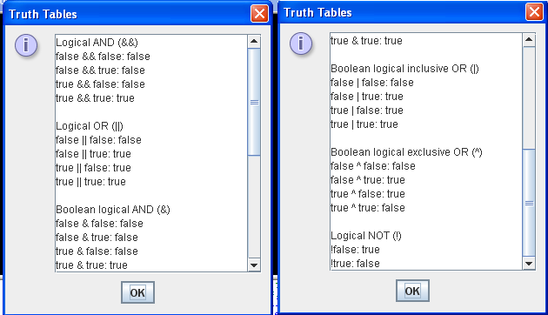
Task 2
Write Java code to generate the given output

